Slide 1
Qaseem Aslam
Abdullah Zafar

Slide 2

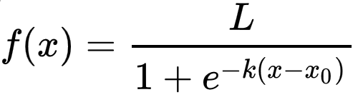
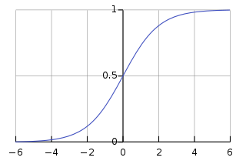
Logistic Regression
Logistic Regression is a statistical model used for classification. It uses logistic function as its base. It estimates a multiple linear regression function defined as:
Logistic function it uses is an s-shaped curve defined by equation:
Curve is represented in the figure below:

Slide 3
Model Properties
Solver used was lbfgs. It stands for Limited-memory Broyden–Fletcher–Goldfarb–Shanno. It is a memory efficient solver as it only saves the last few updates the approximation of second derivative matrix update.
All the classes were given equal weight of 1.
Inverse of regularization strength was set 1.
Tolerance for stopping criteria was set 1e-4.
Cite: https://scikit-learn.org/stable/modules/generated/sklearn.linear_model.LogisticRegression.html

Slide 4
Results of Random Forest Classifier
We used following combinations of the features in our Model to train and test with 70-30 percent train-test split respectively. With accuracies as shown:
ASM + Sizes + Section + Byte Count = 80.36%
Sizes = 27.09%
Sizes Both = 34.39%
Byte Count = 57.97%
Section = 46.39%
ASM = 67.58%
Section + Byte Count = 61.59%
ASM + Section = 69.33%
ASM + Byte Count = 79.29%
ASM + Byte Count + Section = 80.24%

